Slide 1


Slide 2
Gimme Leh! Website

Slide 3


Donate a Treasure
Take a Treasure
About us
FAQ
Contact us
Janice12
1
2
3
4
Overview

Slide 4
Donating an item (Website)

Slide 5
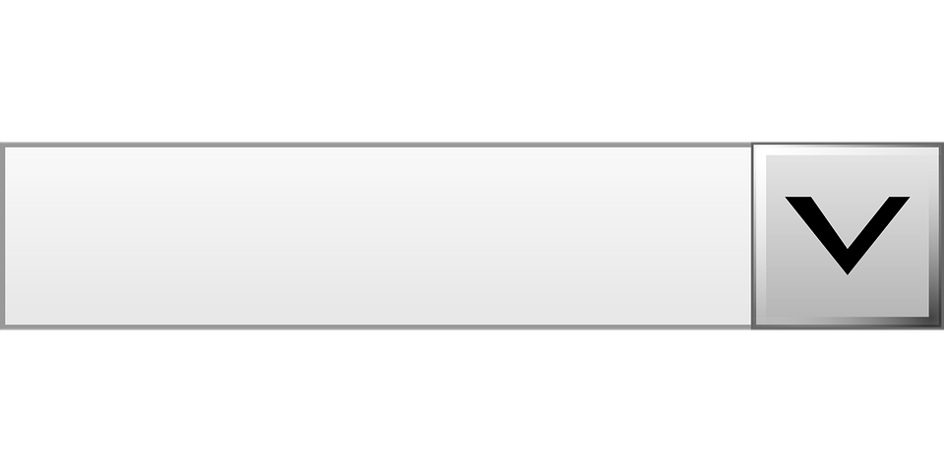
Take a Treasure
About us
Donate a Treasure
FAQ
Contact us
Janice12
Add new treasure
Name:
Location to deposit item:
Upload an image:
Pink Teddy Bear
Choose File
Name:
Location to deposit item:
Upload an image:
1A Chinese Textbook
Choose File
Confirm Donation

Slide 6
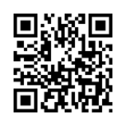
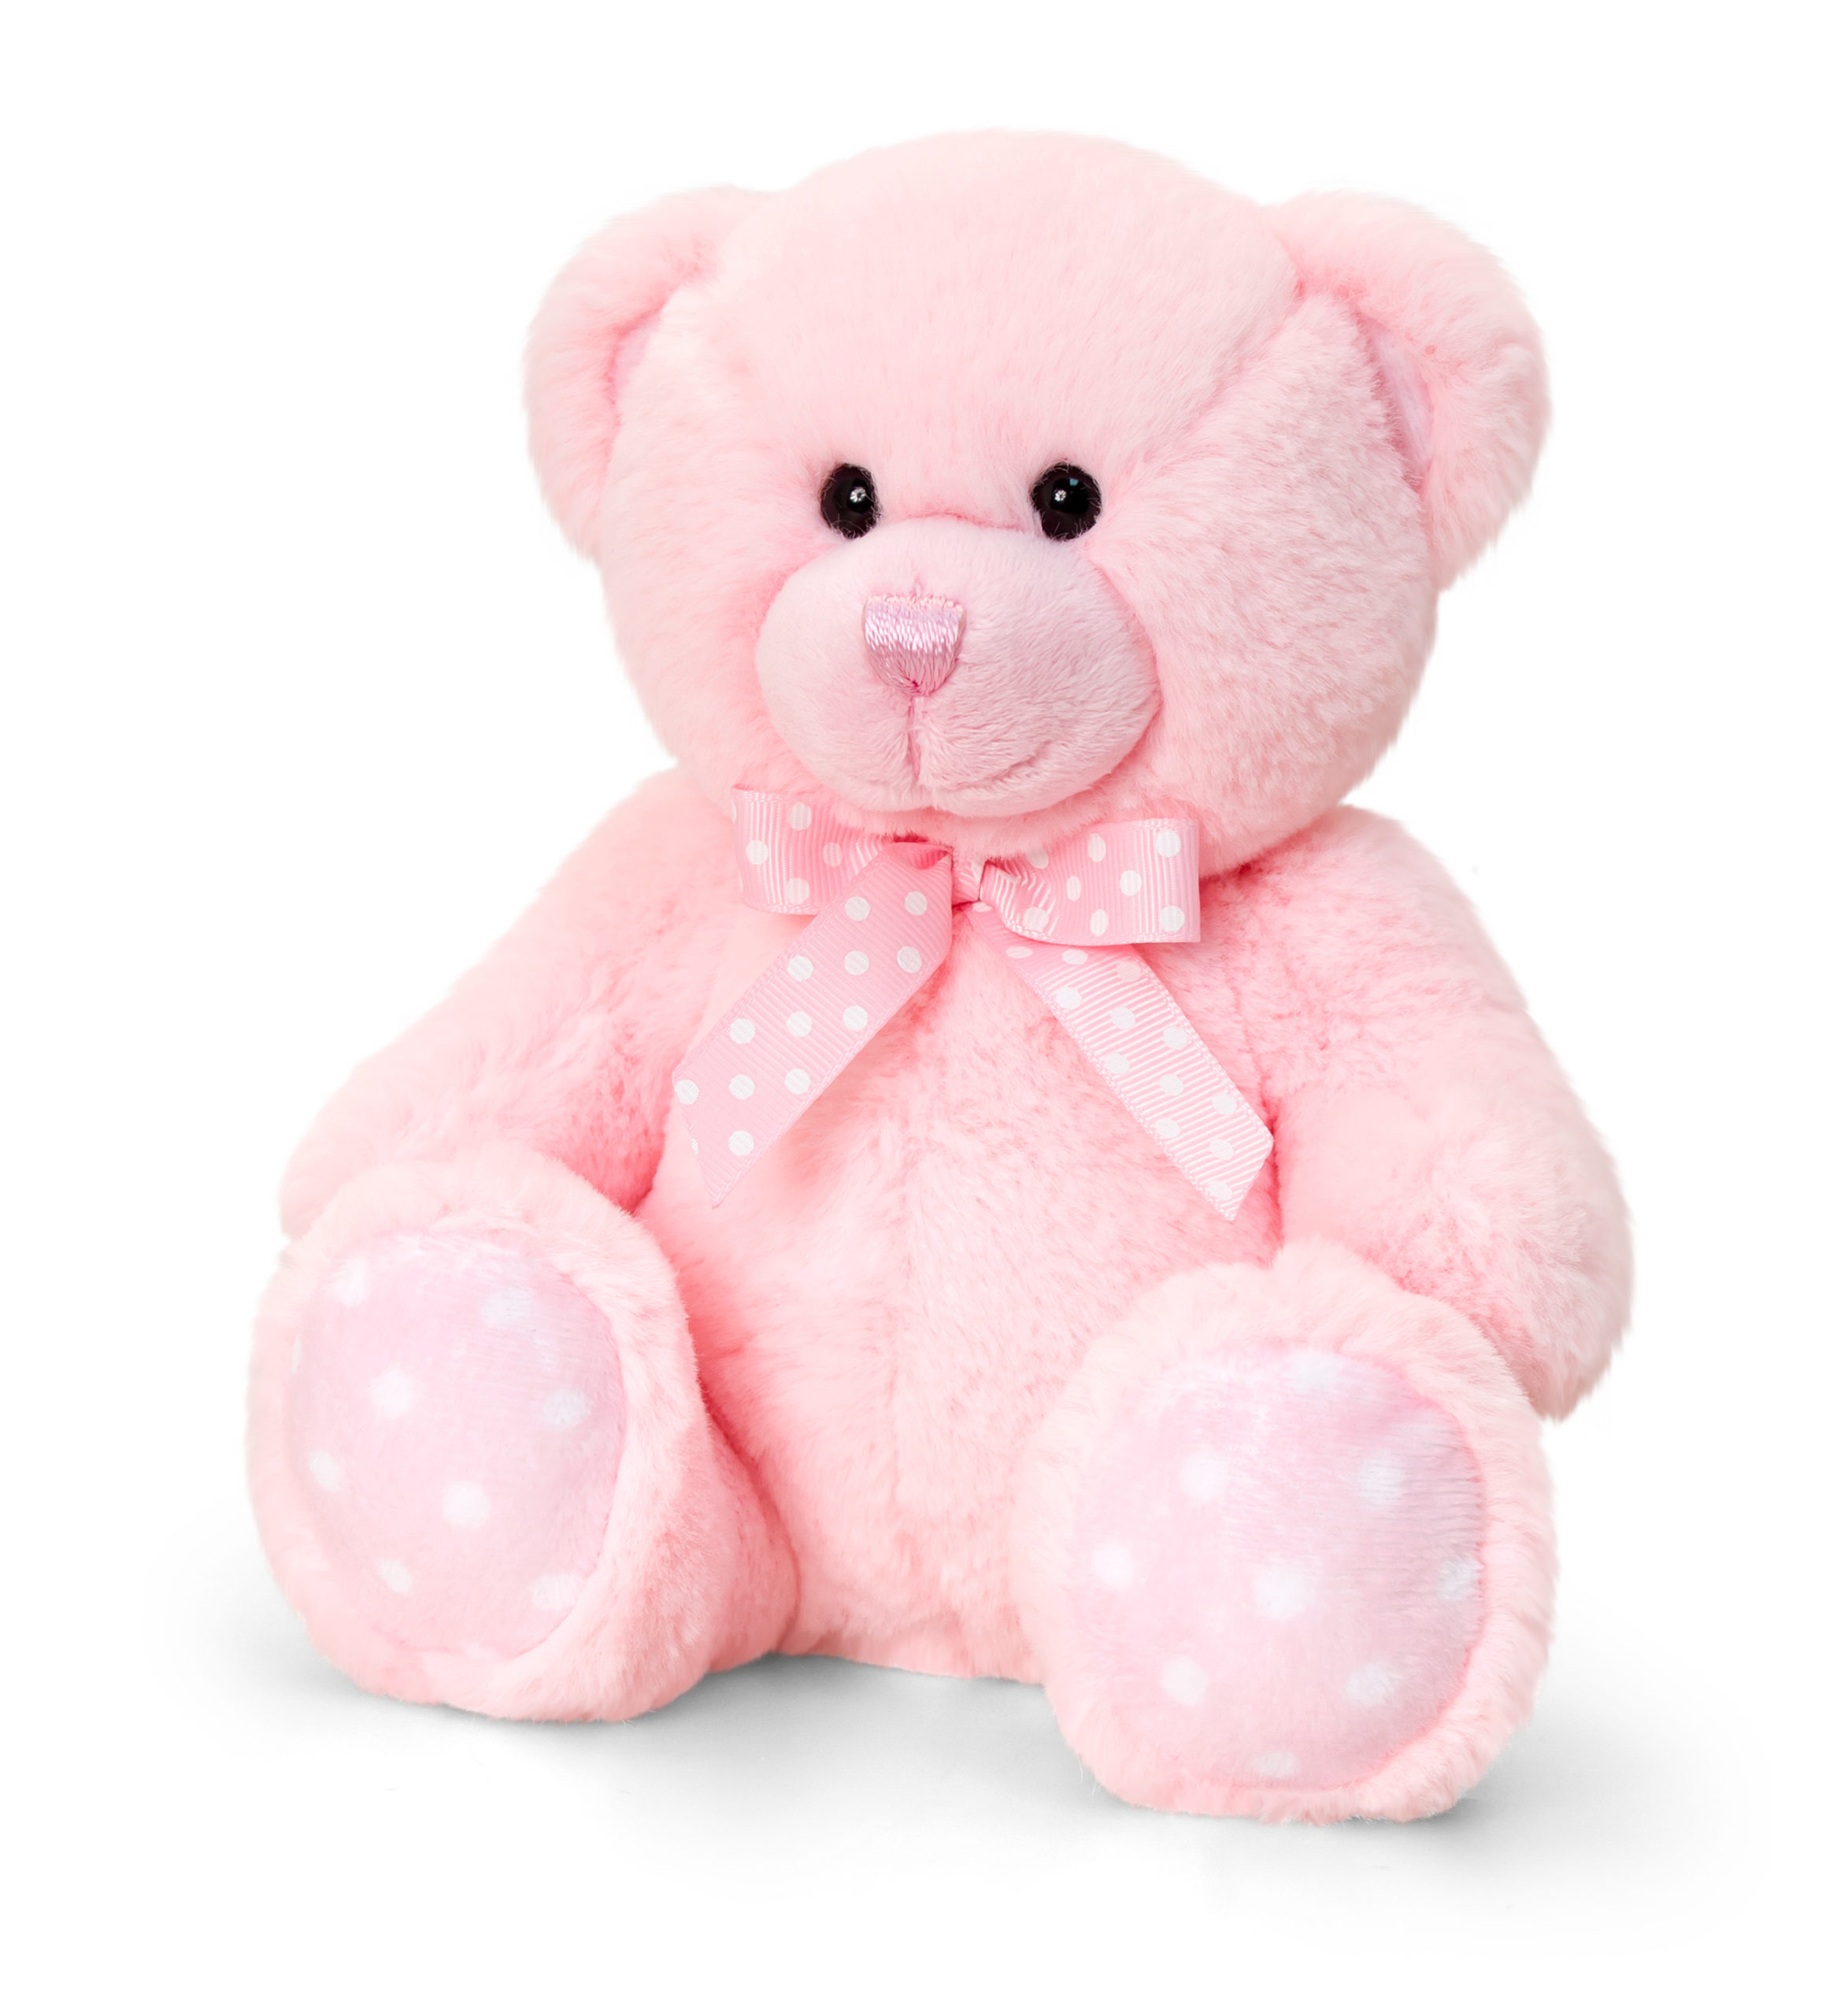

Take a Treasure
About us
Donate a Treasure
FAQ
Contact us
Janice12
Thank you for donating your treasures!
To donate an item, simply go to the treasure box at the corresponding locations and scan the QR code given before dropping it off. All QR codes have been safely stored in your account under "My Donations".
Pink Teddy Bear
1A Chinese Textbook

Slide 7
Taking an item (Website)

Slide 8
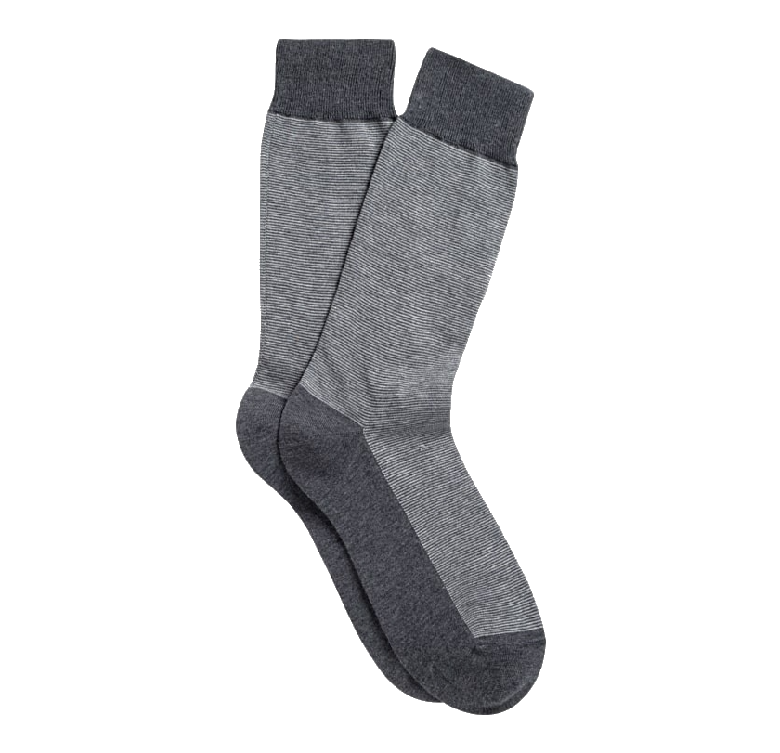

Take a Treasure
About us
Donate a Treasure
FAQ
Contact us
Janice12
Search
Location
Category
Go
Name: Pink Teddy Bear
Location: Seletar Mall
Preloved
Name: Grey Socks
Location: Vivo City
New
Name: Exercise Books
Location: Plaza Sing
New
Add to cart
Add to cart
Add to cart

Slide 9
Take a Treasure
About us
Donate a Treasure
FAQ
Contact us
Janice12
My Cart
Name: Pink Teddy Bear
Location: Seletar Mall
Preloved
Name: 1A Chinese Textbook
Location: Vivo City
Preloved
Confirm Purchase

Slide 10
Take a Treasure
About us
Donate a Treasure
FAQ
Contact us
Janice12
Thank you for giving these items a new home!
To collect you item, simply go to the treasure box at the corresponding locations and scan the QR code given. All QR codes have been safely stored in your account under "My Treasures".
Pink Teddy Bear
1A Chinese Textbook

Slide 11
Treasure Box

Slide 12
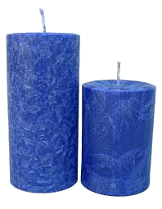
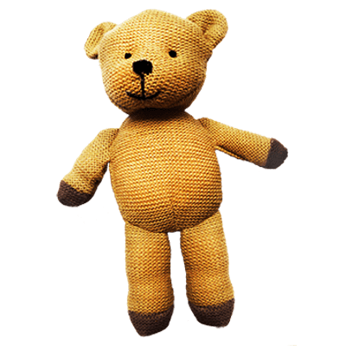
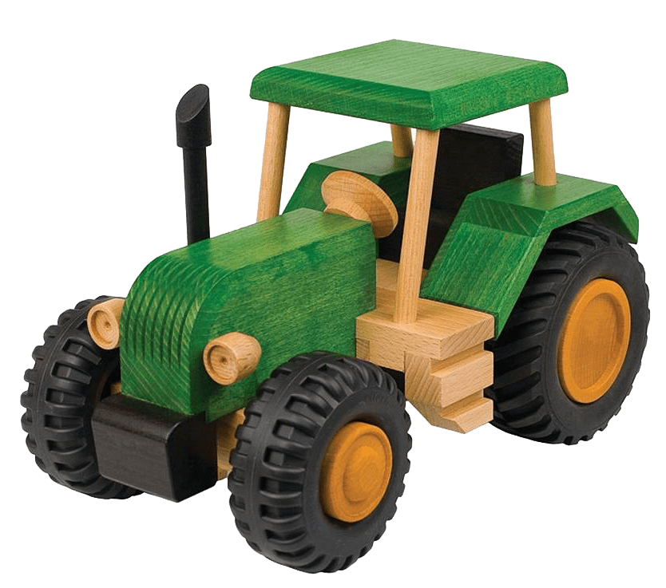
Specifications of the Treasure Box
DONATE
Place QR Code Here
Donated Gifts
QR Code
Scanner
Slots for
Gifts
Touchscreen
Interface
COLLECT
Magnetic Locked
Doorknob
OPEN
Item Retrieval
Point
Item Retrieval
Basket
Figure 1: Closed View
Figure 2: Opened View

Slide 13

Donating An Item
DONATE
Place QR Code Here
COLLECT
OPEN

Slide 14

Donating An Item
Please scan your QR Code for identification
Identification Successful
Please place your item into Slot A2
Place QR Code Here
Place QR Code Here
OPEN
OPEN

Slide 15
Donating An Item
A1
A2
A3
A4
A5
A6
A7
A8
A9
B1
B2

Slide 16
Collecting An Item
DONATE
Place QR Code Here
COLLECT
OPEN

Slide 17
Collecting An Item
Please scan your QR Code for identification
Identification Successful
Please collect your item below
Place QR Code Here
Place QR Code Here
OPEN
OPEN

Slide 18
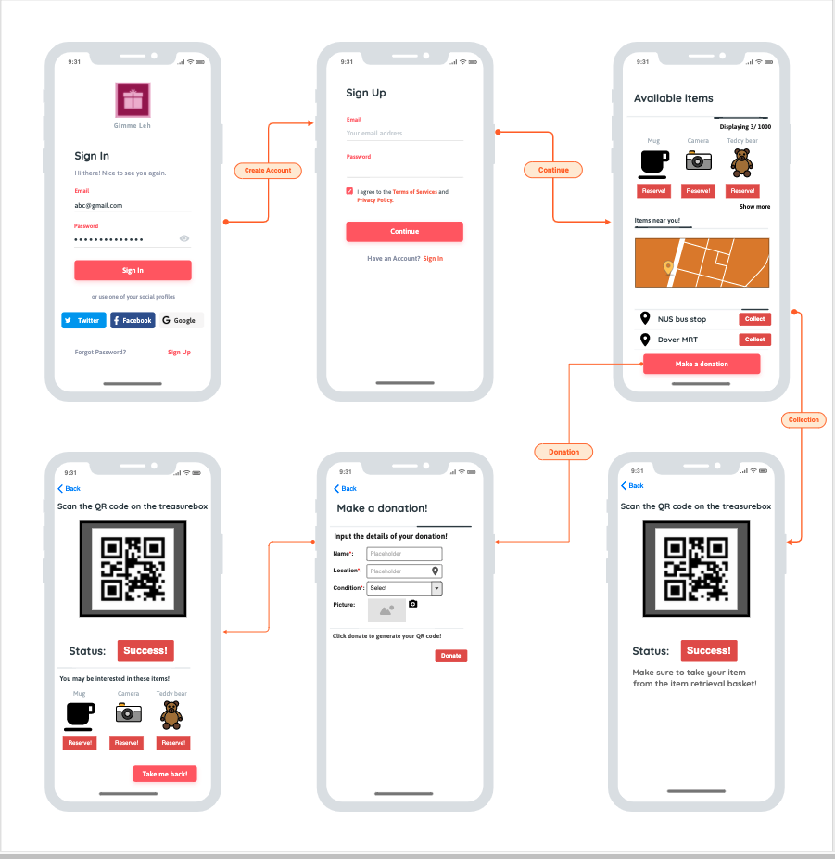
App interface wireframe

Slide 19
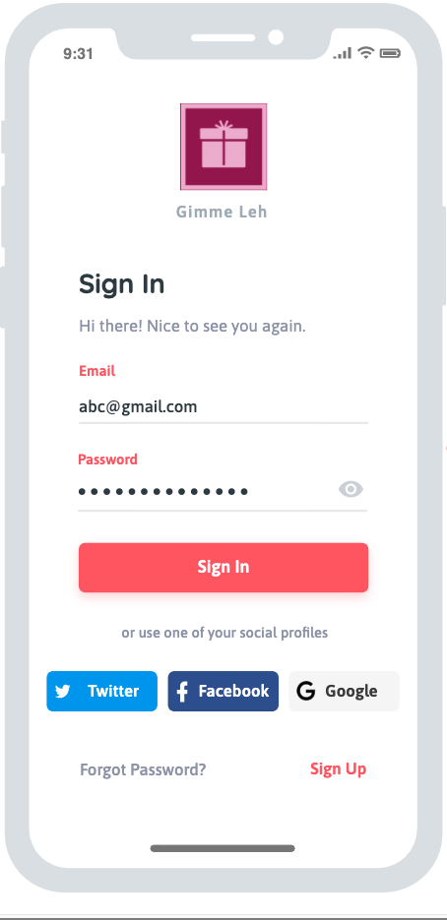
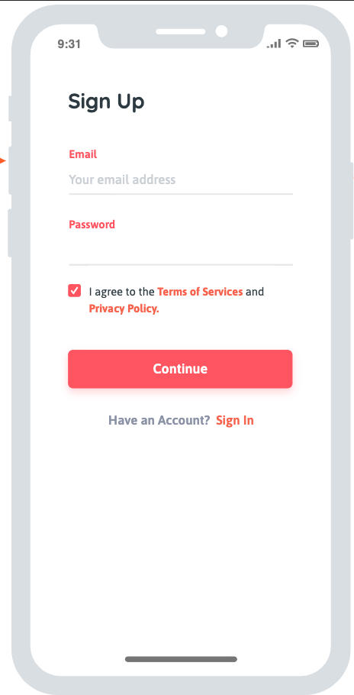
Sign up page
The user is greeted by a sign in page.
The user can log in using an existing social media account, or create a new Gimme Leh account by using a valid email address

Slide 20
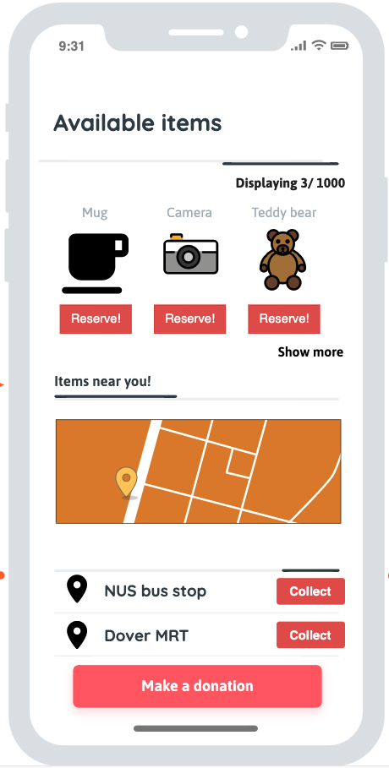
Main page
The main page of the application provides easy access for the user to collect any item. It displays the nearest collection points and some of the items available for collection
A prominent donation button is also present for the user to make a donation

Slide 21
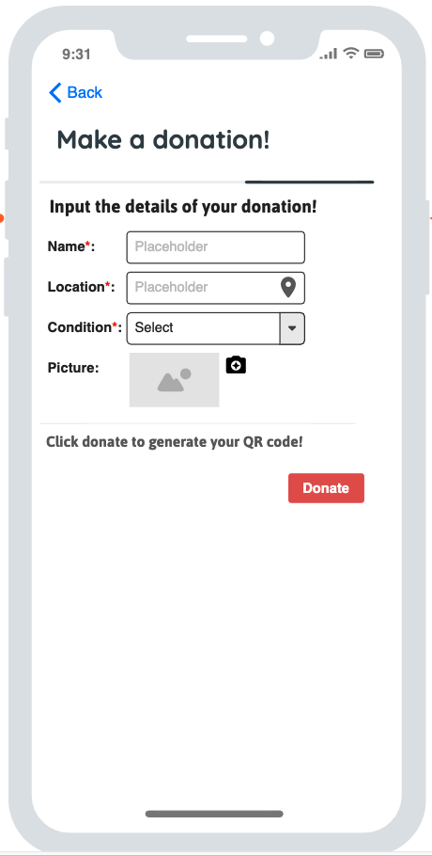
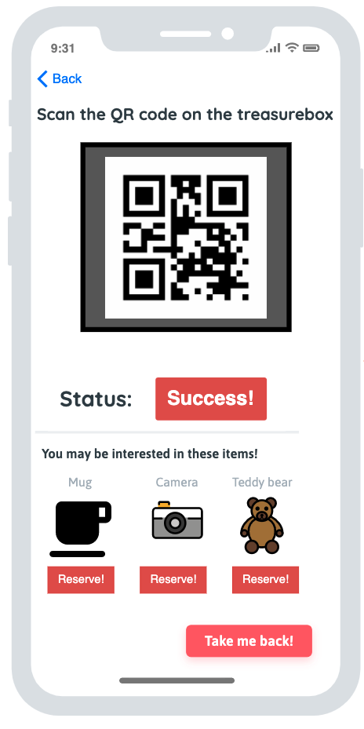
Donation page
To make a donation, the user will have to key in details which will help to catalogue the items.
Once the details have been entered, the app will generate a QR code, which is then to be scanned on the treasure box to complete the donation

Slide 22
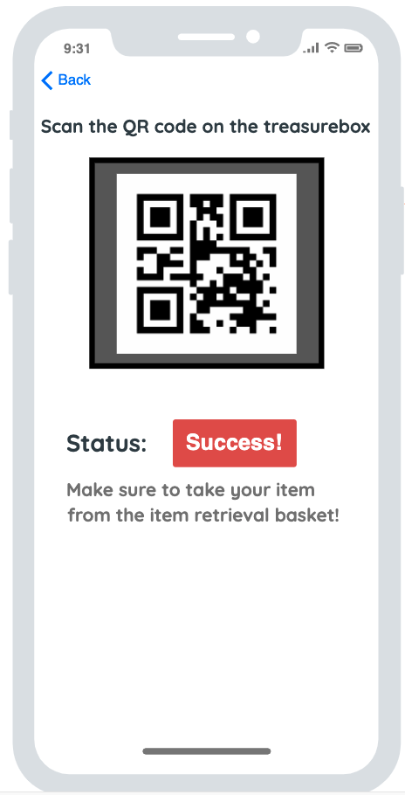
Collection
page
The collection page functions similarly. Once the user selects the items he wants on the main page, a QR code will be generated. This will be scanned by the treasurebox, which will then release the item for collection.

